Slide 1
Some Fundamental Concepts
UNIT - II

Slide 2
Fundamental Concepts
Processor fetches one instruction at a time and perform the operation specified.
Instructions are fetched from successive memory locations until a branch or a jump instruction is encountered.
Processor keeps track of the address of the memory location containing the next instruction to be fetched using Program Counter (PC).
Instruction Register (IR)

Slide 3
Executing an Instruction
Fetch the contents of the memory location pointed to by the PC. The contents of this location are loaded into the IR (fetch phase).
IR ← [[PC]]
Assuming that the memory is byte addressable, increment the contents of the PC by 4 (fetch phase).
PC ← [PC] + 4
Carry out the actions specified by the instruction in the IR (execution phase).

Slide 4
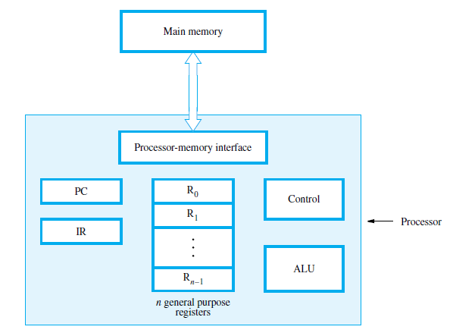

Slide 5
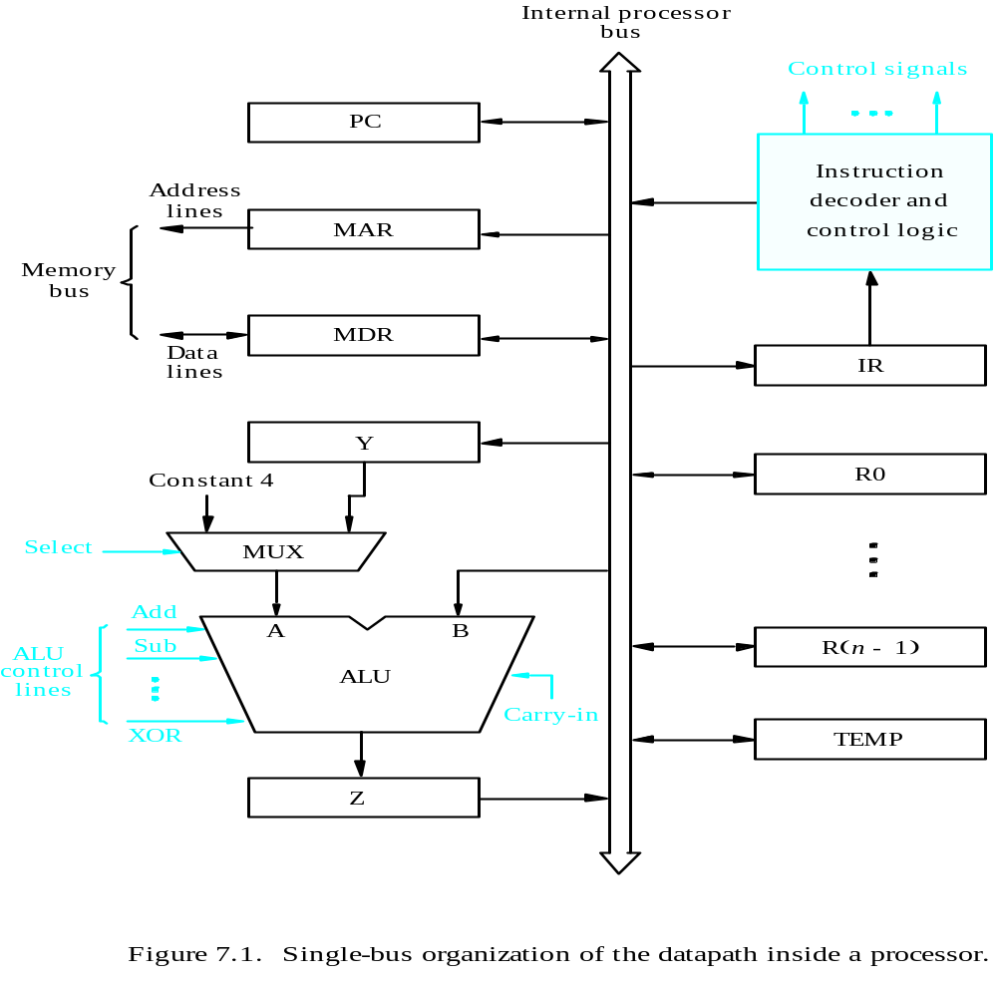
Processor Organization
Datapath
Textbook Page 413

Slide 6
Internal organization of the processor
ALU
Registers for temporary storage
Various digital circuits for executing different micro operations.(gates, MUX,decoders,counters).
Internal path for movement of data between ALU and registers.
Driver circuits for transmitting signals to external units.
Receiver circuits for incoming signals from external units.

Slide 7
PC:
Keeps track of execution of a program
Contains the memory address of the next instruction to be fetched and executed.
MAR:
Holds the address of the location to be accessed.
I/P of MAR is connected to Internal bus and an O/P to external bus.
MDR:
Contains data to be written into or read out of the addressed location.
IT has 2 inputs and 2 Outputs.
Data can be loaded into MDR either from memory bus or from internal processor bus.
The data and address lines (of external memory bus) are connected to the internal bus via MDR and MAR.

Slide 8
Registers:
The processor registers R0 to Rn-1 vary considerably from one processor to another.
Registers are provided for general purpose used by programmer.
Special purpose registers-index & stack registers.
Registers Y, Z &TEMP are temporary registers used by processor during the execution of some instruction.
Multiplexer:
Select either the output of the register Y or a constant value 4 to be provided as input A of the ALU.
Constant 4 is used by the processor to increment the contents of PC.

Slide 9
ALU:
Used to perform arithmetic and logical operation.
Instruction Decoder & Control Logic:
Implements actions specified by the instructions in the IR.
The decoder generates the control signals needed to select the registers involved and direct the transfer of data.
Data Path:
The registers, ALU and interconnecting bus are collectively referred to as the data path.

Slide 10
Register Transfers
Internal processor
b
us
R
i
in
R
i
R
i
out
Y
in
Y
Constant 4
Select
MUX
A
B
ALU
Z
in
Z
Textbook Page 416
Z
out
Figure 7.2. Input and output gating for the registers in Figure 7.1.

Slide 11
The input and output gates for register Ri are controlled by signals is R_{in} and R_{iout .}
R_{in} Is set to1 – data available on common bus are loaded into Ri.
R_{iout} Is set to1 – the contents of register are placed on the bus.
R_{iout} Is set to 0 – the bus can be used for transferring data from other registers .

Slide 12
Data transfer between two registers:
EX:
Transfer the contents of R1 to R4.
Enable output of register R1 by setting R1out=1. This places the contents of R1 on the processor bus.
Enable input of register R4 by setting R4in=1. This loads the data from the processor bus into register R4.

Slide 13
Architecture
Internal processor
b
us
R
i
in
R
i
R
i
out
Y
in
Y
Constant 4
Select
MUX
A
B
ALU
Z
in
Z
Z
out
Figure 7.2. Input and output gating for the registers in Figure 7.1.

Slide 14
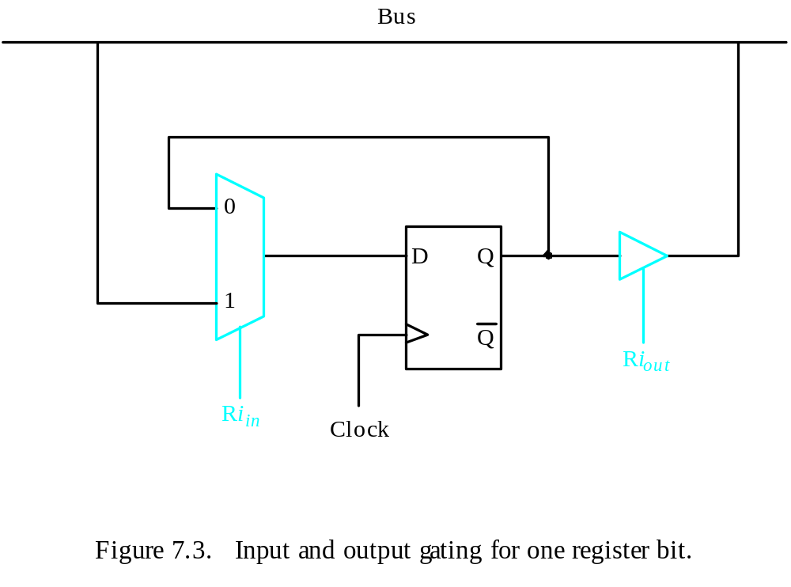
Register Transfers
All operations and data transfers are controlled by the processor clock.
Figure 7.3. Input and output gating for one register bit.

Slide 15
Performing an Arithmetic or Logic Operation
The ALU is a combinational circuit that has no internal storage.
ALU gets the two operands from MUX and bus. The result is temporarily stored in register Z.
What is the sequence of operations to add the contents of register R1 to those of R2 and store the result in R3?
  R1out, Yin
  R2out, SelectY, Add, Zin
  Zout, R3in

Slide 16
Step 1: Output of the register R1 and input of the register Y are enabled, causing the contents of R1 to be transferred to Y.
Step 2: The multiplexer’s select signal is set to select Y causing the multiplexer to gate the contents of register Y to input A of the ALU.
Step 3: The contents of Z are transferred to the destination register R3.

Slide 17
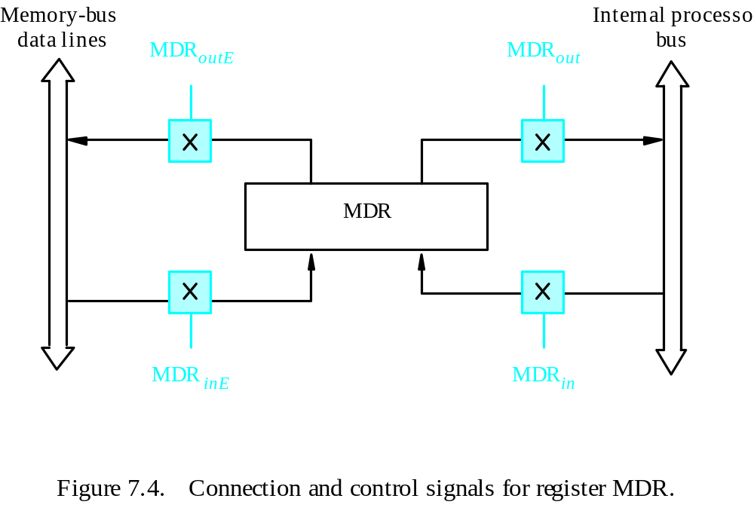
Fetching a Word from Memory
Address into MAR; issue Read operation; data into MDR.
Figure 7.4. Connection and control signals for register MDR.

Slide 18
Fetching a Word from Memory
The response time of each memory access varies (cache miss, memory-mapped I/O,…).
To accommodate this, the processor waits until it receives an indication that the requested operation has been completed (Memory-Function-Completed, MFC).
Move (R1), R2
MAR ← [R1]
Start a Read operation on the memory bus
Wait for the MFC response from the memory
Load MDR from the memory bus
R2 ← [MDR]

Slide 19
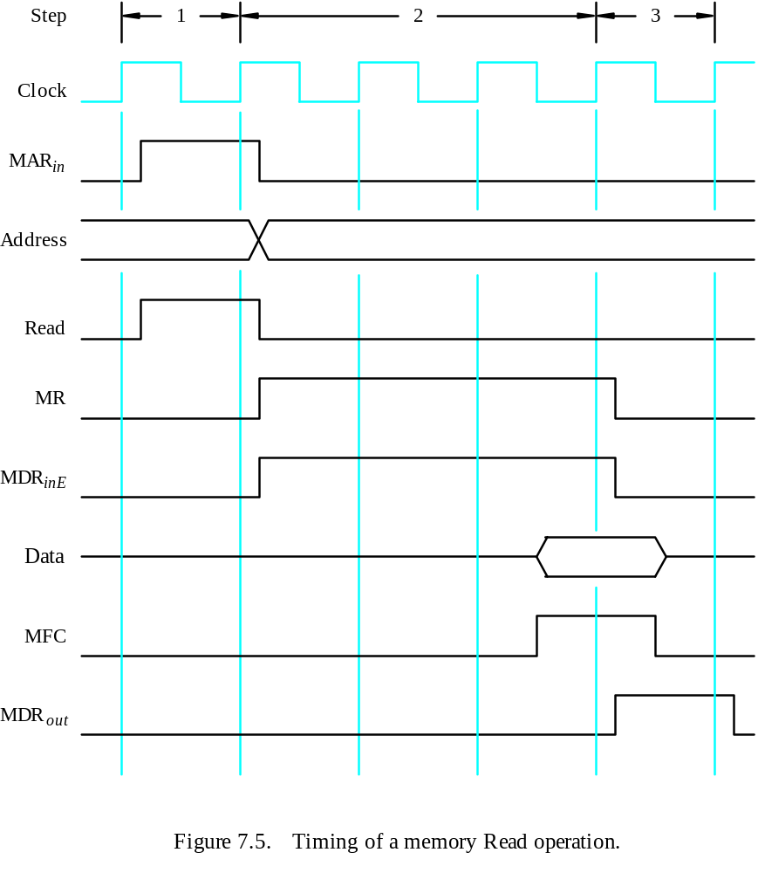
Timing
Assume MAR
is always available
on the address lines
of the memory bus.
Move (R1), R2
R1out, MARin, Read
MDRinE, WMFC
MDRout, R2in

Slide 20
storing a word in memory
Address is loaded into MAR
Data to be written loaded into MDR.
Write command is issued.
Example:Move R2,(R1)
R1_{out},MAR_{in}
R2_{out},MDR_{in},Write
  MDR_{outE}, WMFC

Slide 21
Execution of a Complete Instruction
Add (R3), R1
Fetch the instruction
Fetch the first operand (the contents of the memory location pointed to by R3)
Perform the addition
Load the result into R1

Slide 22
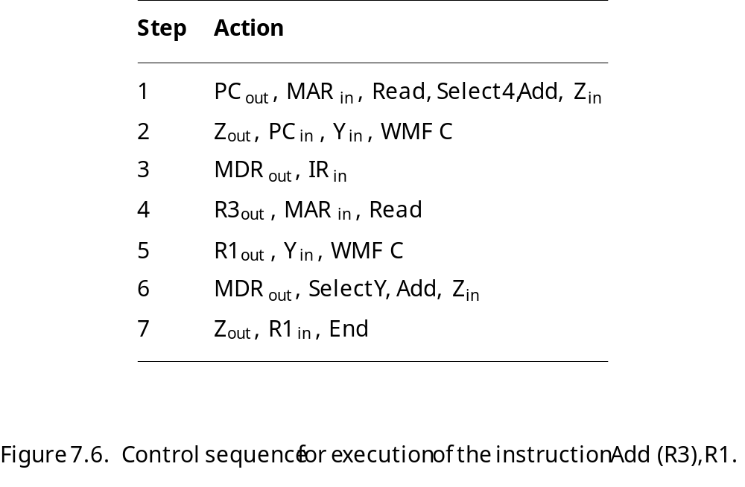
Execution of a Complete Instruction
Add (R3), R1

Slide 23
Execution of Branch Instructions
A branch instruction replaces the contents of PC with the branch target address, which is usually obtained by adding an offset X given in the branch instruction.
The offset X is usually the difference between the branch target address and the address immediately following the branch instruction.
UnConditional branch

Slide 24
Execution of Branch Instructions
Step
Action
1
PC
out
,
MAR
in
,
Read,
Select4,
Add,
Z
in
2
Z
out
,
PC
in
,
Y
in
,
WMF
C
3
MDR
out
,
IR
in
4
Offset-field-of-IR
out
,
Add,
Z
in
5
Z
out
,
PC
in
,
End
Figure 7.7. Control sequence for an unconditional branch instruction.

Slide 25
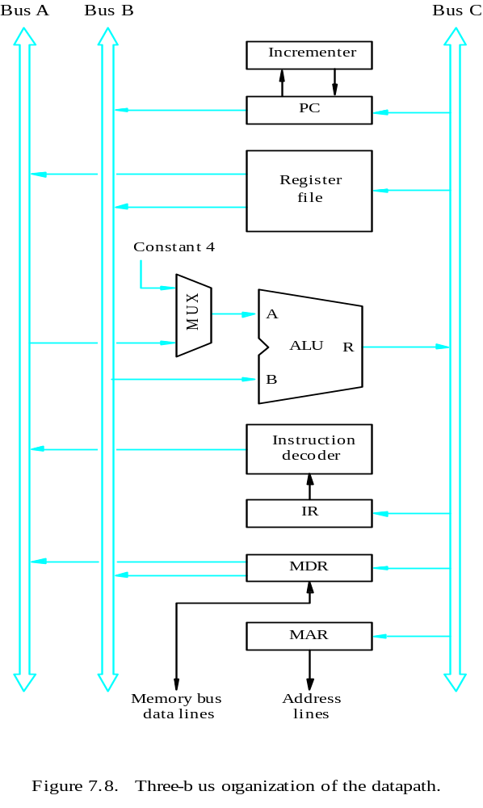
Multiple-Bus Organization
Textbook Page 424
Allow the contents of two different registers to be accessed simultaneously and have their contents placed on buses A and B.
Allow the data on bus C to be loaded into a third register during the same clock cycle.
Incrementer unit.
ALU simply passes one of its two input operands unmodified to bus C
→ control signal: R=A or R=B

Slide 26
General purpose registers are combined into a single block called registers.
3 ports,2 output ports –access two different registers and have their contents on buses A and B
Third port allows data on bus c during same clock cycle.
Bus A & B are used to transfer the source operands to A & B inputs of the ALU.
ALU operation is performed.
The result is transferred to the destination over the bus C.

Slide 27
ALU may simply pass one of its 2 input operands unmodified to bus C.
The ALU control signals for such an operation R=A or R=B.
Incrementer unit is used to increment the PC by 4.
Using the incrementer eliminates the need to add the constant value 4 to the PC using the main ALU.
The source for the constant 4 at the ALU input multiplexer can be used to increment other address such as loadmultiple & storemultiple

Slide 28
Multiple-Bus Organization
Add R4, R5, R6
Step
Action
1
PC
out
,
R=B,
MAR
in
,
Read,
IncPC
2
WMF
C
3
MDR
outB
,
R=B,
IR
in
4
R4
outA
,
R5
outB
,
SelectA,
Add,
R6
in
,
End
Figure 7.9. Control sequence for the instruction. Add R4,R5,R6,
for the three-bus organization in Figure 7.8.

Slide 29
Step 1:The contents of PC are passed
through the ALU using R=B control signal & loaded into MAR to start a memory read operation
At the same time PC is incremented by 4
Step 2:The processor waits for MFC
Step 3: Loads the data received into MDR, then transfers them to IR.
Step 4: The execution phase of the instruction requires only one control step to complete.

Slide 30
Hardwired Control

Slide 31
Overview
To execute instructions, the processor must have some means of generating the control signals needed in the proper sequence.
Two categories: hardwired control and microprogrammed control
Hardwired system can operate at high speed; but with little flexibility.

Slide 32
Control Unit Organization
Clock
CLK
Control step
counter
External
inputs
Decoder/
IR
encoder
Condition
codes
Control signals
Figure 7.10. Control unit organization.

Slide 33
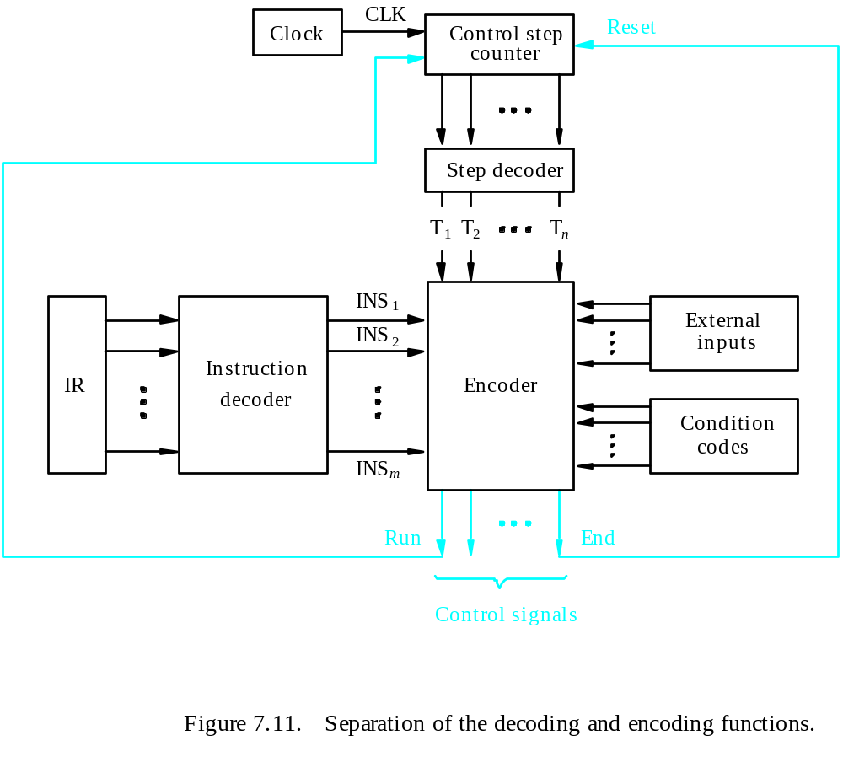
Detailed Block Description

Slide 34
Generating Z_{in}
Z_{in} = T₁ + T₆ • ADD + T₄ • BR + …
Branch
Add
T
4
T
6
T
1
Figure 7.12. Generation of the Z_{in} control signal for the processor in Figure 7.1.

Slide 35
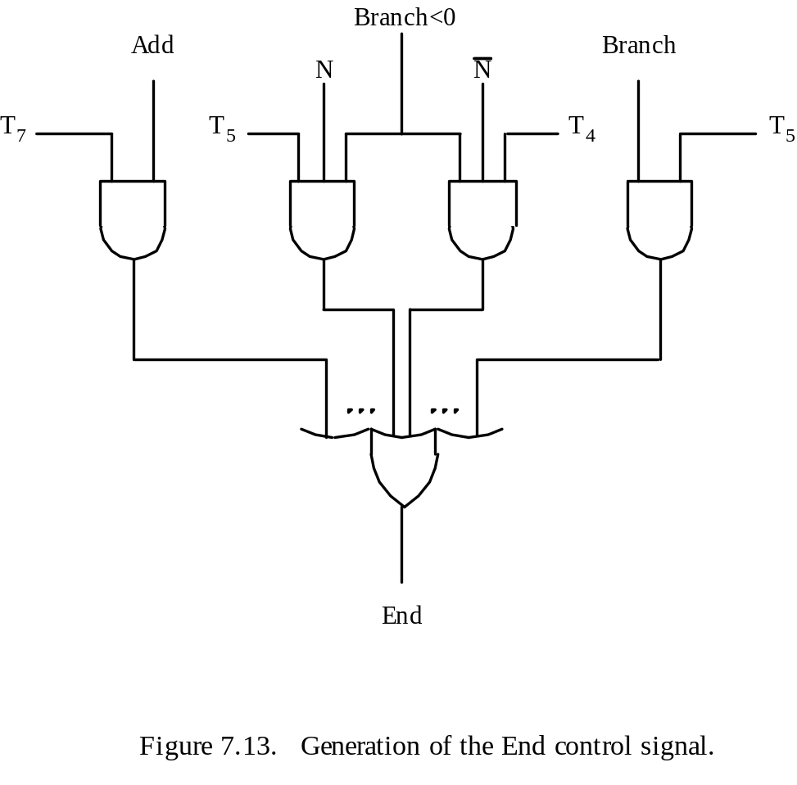
Generating End
End = T₇ • ADD + T₅ • BR + (T₅ • N + T₄ • N) • BRN +…

Slide 36
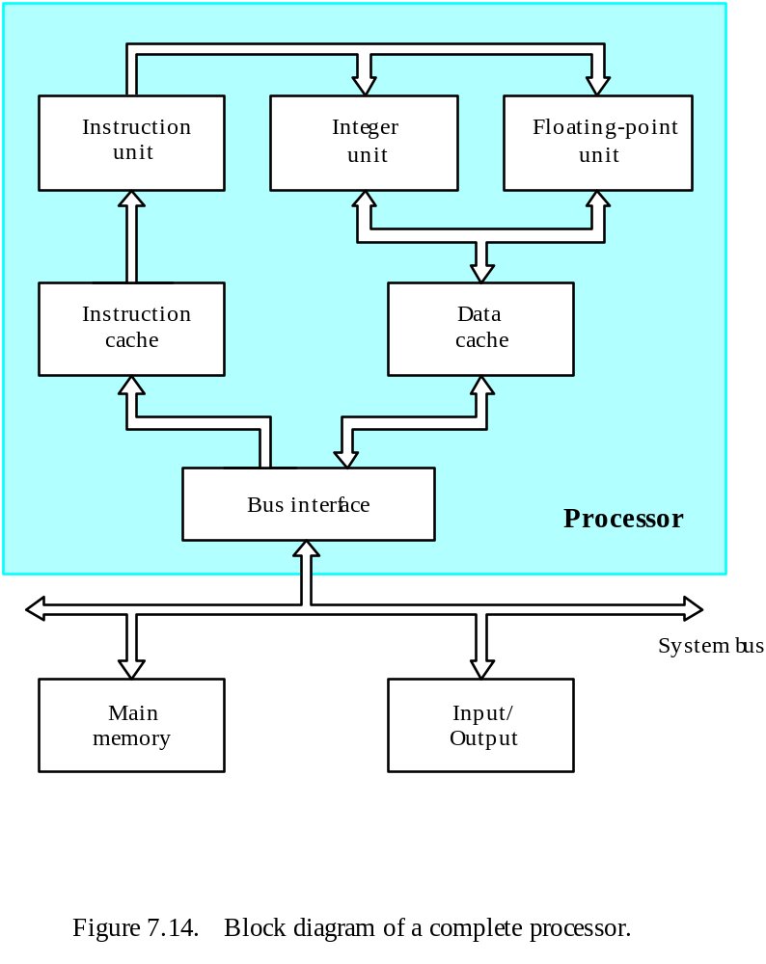
A Complete Processor

Slide 37
Microprogrammed Control

Slide 38
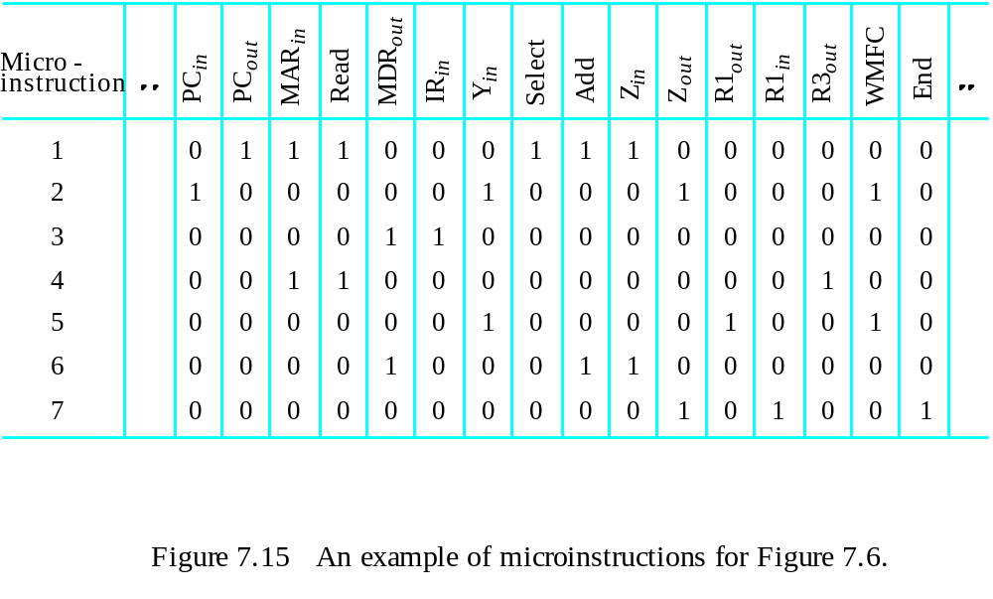
Microprogrammed Control
Control signals are generated by a program similar to machine language programs.
Control Word (CW); microroutine; microinstruction
: Textbook page430

Slide 39
Overview
Textbook page 421

Slide 40
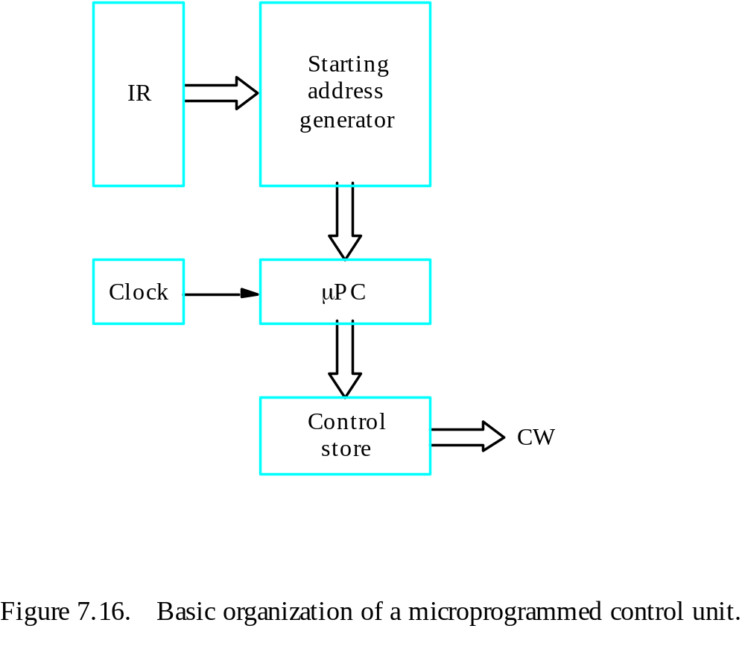
Basic organization of a microprogrammed control unit
Control store
One function
cannot be carried
out by this simple
organization.

Slide 41
Conditional branch
The previous organization cannot handle the situation when the control unit is required to check the status of the condition codes or external inputs to choose between alternative courses of action.
Use conditional branch microinstruction.
Address
Microinstruction
0
PC
out
,
MAR
in
,
Read,
Select4,
Add,
Z
in
1
Z
out
,
PC
in
,
Y
in
,
WMF
C
2
MDR
out
,
IR
in
3
Branch
to
starting
address
of
appropriate
microroutine
.
.
.
.
.
.
.
.
.
.
.
.
.
.
.
.
.
.
.
.
.
.
.
.
.
.
.
.
.
.
.
.
.
.
.
.
.
.
.
.
.
.
.
.
.
.
.
.
.
.
.
.
.
.
.
.
.
.
.
.
.
.
.
.
.
.
25
If
N=0,
then
branch
to
microinstruction
0
26
Offset-field-of-IR
out
,
SelectY,
Add,
Z
in
27
Z
out
,
PC
in
,
End
Figure 7.17. Microroutine for the instruction Branch<0.

Slide 42
Microprogrammed Control
External
inputs
Starting and
Condition
IR
branch address
codes
generator
Clock
μ
P
C
Control
CW
store
Figure 7.18. Organization of the control unit to allow
conditional branching in the microprogram.

Slide 43
Microinstructions
A straightforward way to structure microinstructions is to assign one bit position to each control signal.
However, this is very inefficient.
The length can be reduced: most signals are not needed simultaneously, and many signals are mutually exclusive.
All mutually exclusive signals are placed in the same group in binary coding.

Slide 44
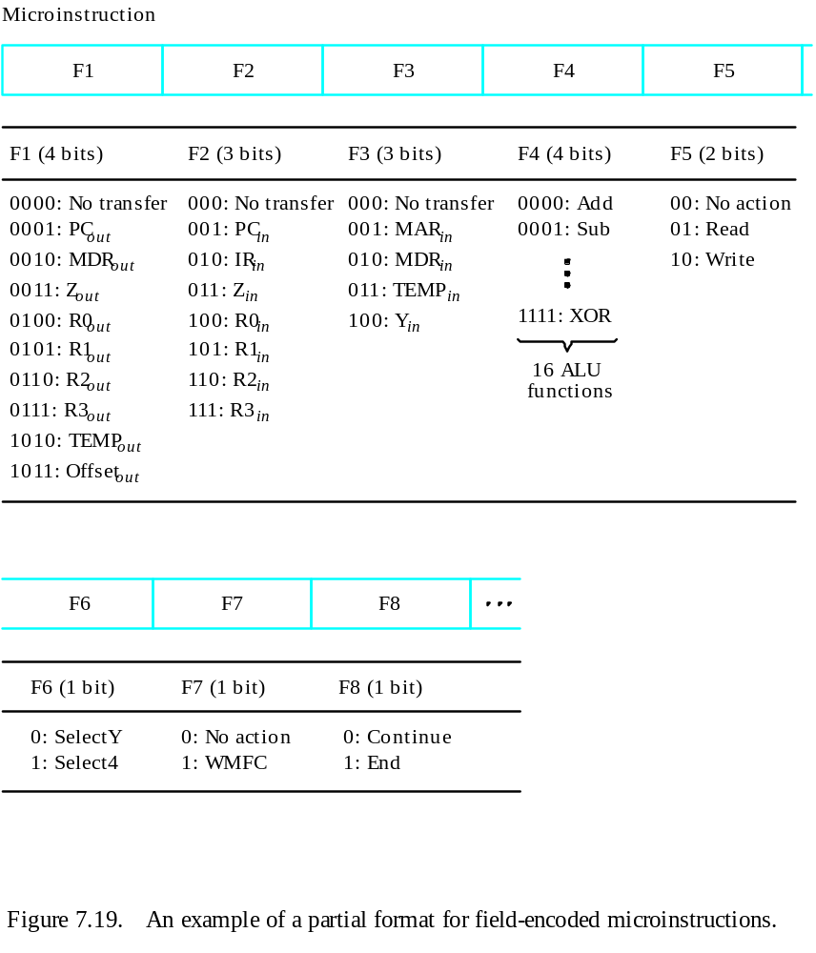
Partial Format for the Microinstructions
What is the price paid for
this scheme?
Require a little more hardware

Slide 45
Further Improvement
Enumerate the patterns of required signals in all possible microinstructions. Each meaningful combination of active control signals can then be assigned a distinct code.
Vertical organization
Horizontal organization
Textbook page 434

Slide 46
Microprogram Sequencing
If all microprograms require only straightforward sequential execution of microinstructions except for branches, letting a μPC governs the sequencing would be efficient.
However, two disadvantages:
Having a separate microroutine for each machine instruction results in a large total number of microinstructions and a large control store.
Longer execution time because it takes more time to carry out the required branches.
Example: Add src, Rdst
Four addressing modes: register, autoincrement, autodecrement, and indexed (with indirect forms).

Slide 47
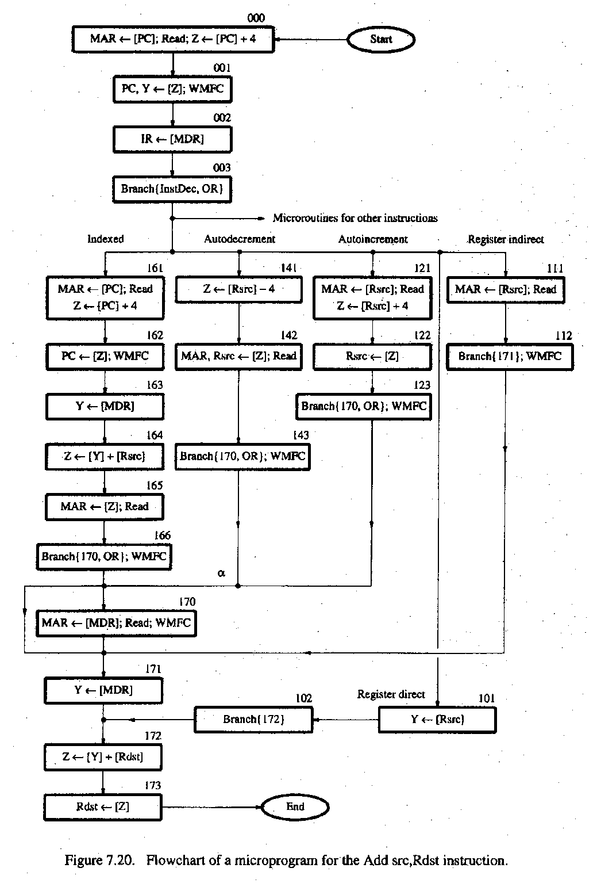
Textbook page 436
- Bit-ORing
- Wide-Branch Addressing
- WMFC

Slide 48
Mode
Contents of IR
OP code
0
1
0
Rsrc
Rdst
11
10
8
7
4
3
0
Address
Microinstruction
Textbook page 439
(octal)
000
PC
, MAR
, Read, Select
, Add, Z
out
in
4
in
001
Z
out
, PC
in
, Y
in
, WMFC
002
MDR
out
, IR
in
003
μ
Branch {
μ
PC
←
101 (from Instruction decoder);
μ
PC
5,4
←
[IR
10,9
];
μ
PC
3
←
[IR
10
]
⋅
[IR
9
]
⋅
[IR
8
]}
121
Rsrc
, MAR
, Read, Select4, Add, Z
out
in
in
122
Z
out
, Rsrc
in
123
μ
Branch {
μ
PC
←
170;
μ
PC
0
←
[IR
8
]}, WMFC
170
MDR
out
, MAR
in
, Read, WMFC
171
MDR
out
, Y
in
172
Rdst
out
, SelectY
, Add, Z
in
173
Z
out
, Rdst
in
, End
Figure 7.21.
Microinstruction for Add (Rsrc)+,Rdst.
Note:
Microinstruction at location 170 is not executed for this addressing mode.

Slide 49
Microinstructions with Next-Address Field
The microprogram we discussed requires several branch microinstructions, which perform no useful operation in the datapath.
A powerful alternative approach is to include an address field as a part of every microinstruction to indicate the location of the next microinstruction to be fetched.
Pros: separate branch microinstructions are virtually eliminated; few limitations in assigning addresses to microinstructions.
Cons: additional bits for the address field (around 1/6)

Slide 50
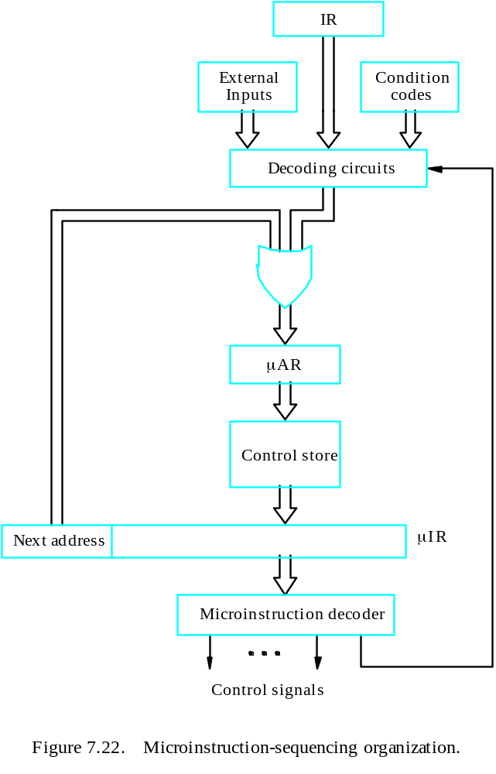
Microinstructions with Next-Address Field

Slide 51
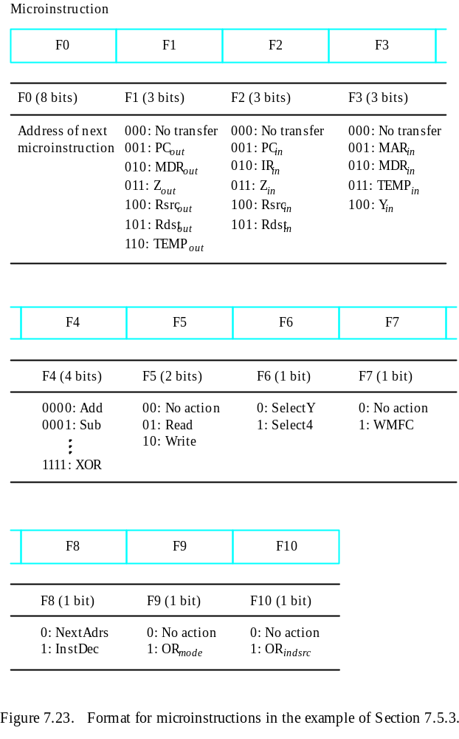

Slide 52
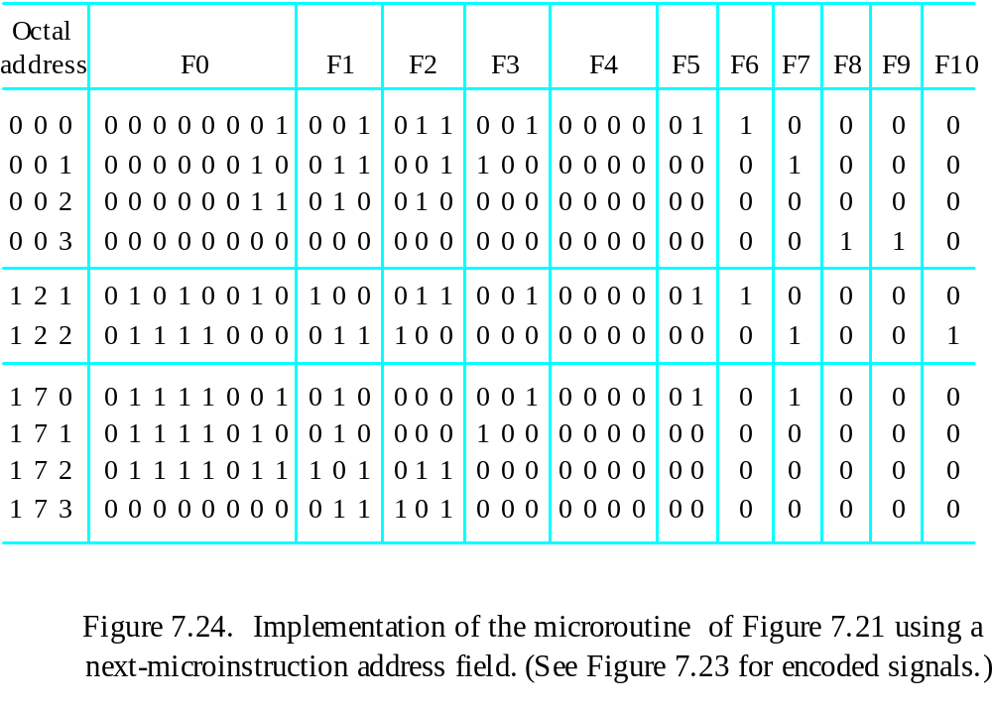
Implementation of the Microroutine

Slide 53
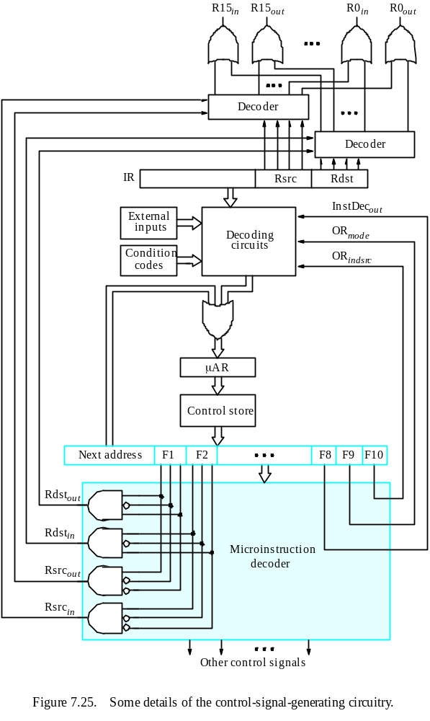

Slide 54
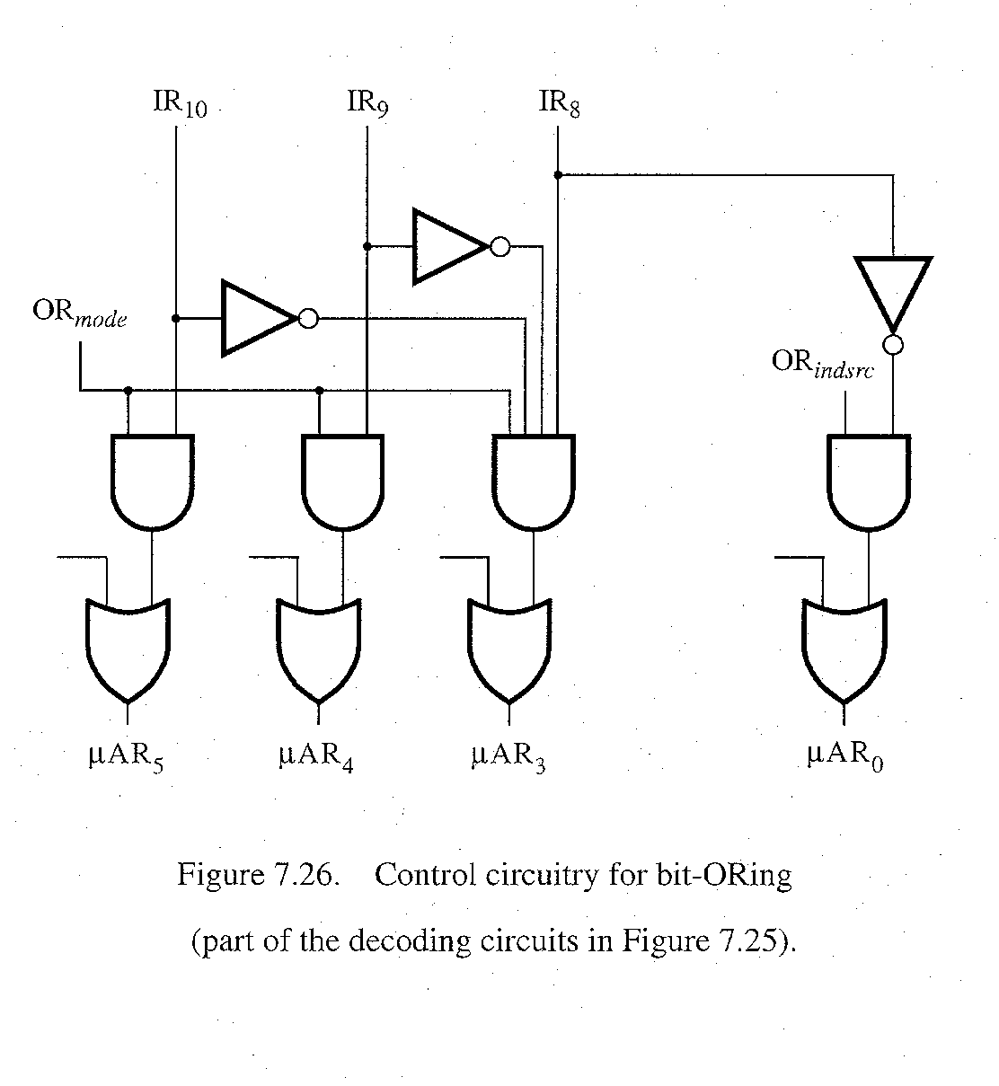
bit-ORing

Slide 55
Further Discussions
Prefetching
Emulation

